Slide 1

University of Victoria
Bank Customer Segmentation with Affinity Propagation and Credit Risk Analysis with Random Forest and ANN
Roma Rico Flores

Slide 2
Introduction
Exploratory Data Analysis
Project Pipeline
Data Cleaning
Data Preparation
Customer Segmentation by Affinity Propagation
Credit Risk Prediction Modeling by Random Forest and ANN
Performance Evaluation

Slide 3

Problem
The problem this project aims to solve is the effective understanding and management of the diverse customer base and the associated credit risks in the banking industry.
By segmenting customers based on their characteristics and behaviours, banks can tailor their products and services to meet specific customer needs, improving customer satisfaction and retention.
Additionally, analyzing credit risk factors helps banks evaluate the likelihood of customers defaulting on loans or being unable to fulfill financial obligations, enabling informed lending decisions, risk management, and fraud detection to protect the financial stability of the institution.

Slide 4
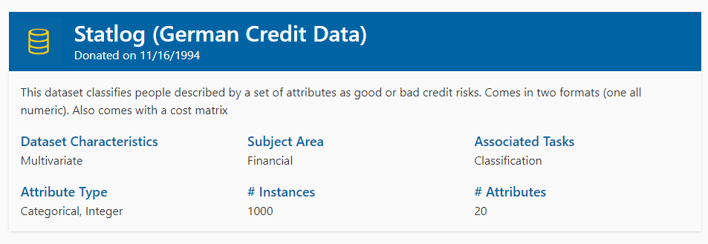
Dataset
University of California, Irvine
(UCI Machine Learning Repository)
Source

Slide 5
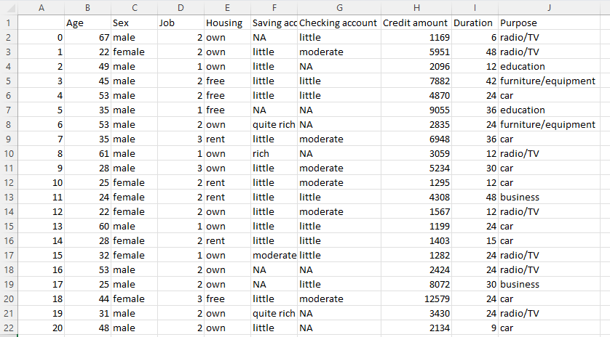
Attributes

Slide 6

Customer Segmentation via Affinity Propagation
Advantages of Affinity Propagation:
Automatic Determination of Cluster Number: Affinity Propagation automatically determines the number of clusters based on the data, which can be beneficial when the optimal number of clusters is unknown or difficult to specify in advance.
Ability to Identify Exemplars: Affinity Propagation identifies exemplar points within each cluster, which can represent prototypical or representative members of the cluster. These exemplars can provide insights into the central tendencies or characteristic features of the clusters.
Suitable for Complex Data: Affinity Propagation can handle complex and non-linear relationships in the data. It can effectively cluster data with irregular shapes, overlapping clusters, and non-spherical distributions.

Slide 7
Credit Risk Analysis via Random Forest and ANN
After segmenting banking customers, analyzing credit risk within each segment is crucial to understand the risk profile and making informed decisions.
Random Forest
Random Forest is an ensemble algorithm that consists of multiple decision trees. Each tree is trained on a random subset of the data, and the final prediction is determined by aggregating the predictions of all individual trees.
ANN
ANN training process involves optimizing the model's weights and biases by minimizing a loss function. The backpropagation algorithm, combined with gradient descent or its variants, is typically used for this purpose. Optimizing the hyperparameters, such as learning rate and batch size would enhance training performance.

